Slide 1

Aidan Smith CS408 - Individual project
Codd02 - Employee Performance management system
marker: Alex Coddington
second marker: martin halvey

Slide 2
OVERVIEW OF PROJECT
Employee performance management system
Web based application
Allowing employees to submit their work on projects/training programs
Allowing managers (and peers) to evaluate employee’s performance
Produce reporting from the information held database
The project completely software engineering based

Slide 3
FUNCTIONAL REQUIREMENTS
Will have two types of users – Employees and Managers
Employees – Submit timesheets and time-entries, give feedback to peers
Managers – Approve/Reject timesheets and time-entries, make suggestions and give feedback regarding performance
System will display tables of employees work and their current status
Display feedback given and manage the performances

Slide 4
NON FUNCTIONAL REQUIREMENTS
Will use windows authentication
DB capacity cannot exceed 20mb if using Microsoft Azure
I plan (at the moment) to host both my application and MySQL database on Microsoft Azure but may decide to switch my database over and host it on Digital Ocean

Slide 5

POLICE SCOTLAND – RESEARCH AND SURVEY RELATED WORK
Ian Davidson - ICT Development Coordinator
Currently 2 systems: Development Requirements & PDR
1. Web form to submit requests for training or pieces of work (sometimes used as form of discipline)
2. Web form to correlate all pieces of work in past 6 months and line managers comment on performance and objectives

Slide 6


PLAN OF TECHNOLOGIES
Environments: Microsoft Visual Studio, SQL Server Management Studio 2012, Microsoft Azure
Programming Languages: ASP.Net, C#, JavaScript, AJAX
Design Pattern: MVC
Database: MySQL
Version control: SVN
Planning/ Tasks: Trello

Slide 7

ALTERNATIVE TECHNOLOGIES
Could easily have used java in eclipse
Will enjoy building in C#
Mobile development could be done using Xamarin mobile developement technology
Could have used GitHub for version control
Could use Digital Ocean to host DB

Slide 8
PROGRESS TO DATE
Met Alex once a week to discuss planning
Decided on technologies to use
Produced plan
Project Scope & Outline Plan
Started creating Logbook
Project Poster Day

Slide 9
EVALUATION
User evaluation and testing
ICT Police Scotland have volunteered to help evaluate my project
Survey
Verbal Feedback

Slide 10
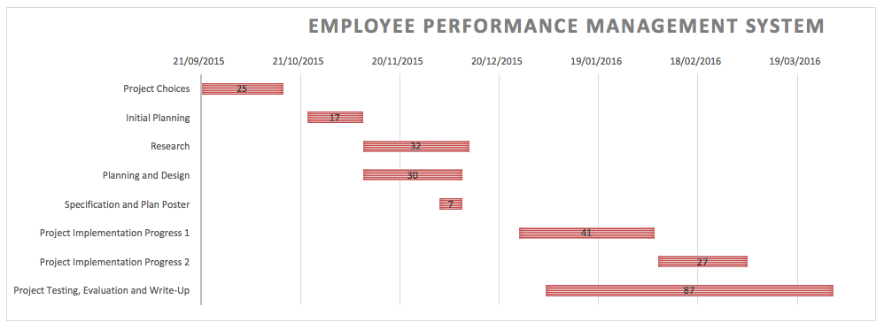
PROJECT PLAN

